Slide 1

Read Rover: Your gateway to affordable reading
Simarpreet Kaur - 24207021
Gauri Kandarkar - 24207013
Riya More - 23107014
Raj Raut - 24207022
Project Guide
Ms. Harsha Zope

Slide 2
Outline
Introduction
Literature Survey of the existing systems
Limitations of the existing systems
Problem statement
System Design
Technologies and methodologies
Implementation
Conclusion
References

Slide 3
Introduction
Book lovers struggle to find affordable, quality used books in a convenient way.
Traditional used bookstores have limited inventory and require physical visits, while mainstream online retailers often focus on new books at higher price points.
Additionally, selling used books can be time-consuming and inefficient for individuals.
There is a need for an accessible online platform that connects readers with affordable second-hand books while providing book owners an easy way to rehome their collections.

Slide 4
Introduction
Objectives:
To provide a budget-friendly platform for buying, selling, and donating pre-owned books.
To promote sustainable reading by encouraging the reuse of books with AI-powered recommendations.
To support literacy and community development through book donations.
To enhance reader engagement using sentiment analysis model.

Slide 5
Literature Survey of the existing system
Sr. No. | Title | Author(s) | Year | Outcomes | Methodology | Result
1. | [1] Collaborative Filtering-Based Book Recommendation System | Dheeraj Parmar and Pankaj Raghuwanshi. | 2025 | The study concludes that ALS is a more scalable, accurate, and robust technique for building collaborative filtering-based book recommendation systems, especially when working with large-scale, sparse datasets. | A comparative study of Alternating Least Squares (ALS) and Singular Value Decomposition (SVD) on the Book-Crossing dataset. | ALS (RMSE: 3.9901) was significantly more accurate than SVD (RMSE: 5.9029)
2. | [2] Systematic Literature Review on Recommender Systems | Ilham Saifudin and Triyanna Widiyaningtyas | 2024 | The paper identifies key trends, challenges, and popular techniques in recommender system research. It concludes that the model-based collaborative filtering method is a prominent approach that can effectively minimize common problems such as cold start, data sparsity, and scalability. . | A Systematic Literature Review (SLR) of 72 research articles published between 2019 and 2023. | Collaborative Filtering is the most common approach (46 studies), and accuracy is the most significant problem addressed (65%).

Slide 6
Literature Survey of the existing system
Sr. No. | Title | Author(s) | Year | Outcomes | Methodology | Result
3. | [3] Integrating AI into Library Systems | Ian Tai and Souvick Ghosh. | 2024 | The paper concludes that AI has vast potential to transform and improve library services by automating tasks and enhancing user experience. To realize this potential, it is crucial to address the significant challenges related to cost, technical skills, and ethical concerns through continued research and development. | This work is a perspective paper that uses an integrative literature review approach to synthesize findings from 43 articles concerning the application of artificial intelligence in library systems. | Key AI application areas include recommendation systems, information retrieval (e.g., chatbots), and Optical Character Recognition (OCR). Major barriers to adoption are the lack of skilled personnel and infrastructure

Slide 7
Limitations of existing systems
From the literature review of existing systems, we find that :
High Costs for Books – Most existing platforms sell new books at high prices, making reading less affordable for students and budget-conscious users.
Lack of Donation & Recycling Features – Few platforms allow users to donate books or promote sustainability, limiting community and eco-friendly initiatives.
Cluttered or Complex UI/UX – Many platforms have confusing navigation, poor design, and excessive ads, which negatively impact user experience.

Slide 8
Limitations of existing systems
Poor Sustainability & Recycling Support- Many systems don’t encourage reuse of books, leading to waste.. No eco-friendly initiative to promote sustainable reading habits.
Dataset Underutilization- Book data (genres, ratings, reviews) is often underused, missing opportunities for smarter search, filtering, and recommendations.

Slide 9
Problem statement
Existing platforms mainly sell new books at high prices, making reading less affordable and accessible, especially for students and low-income readers.
Current systems do not support book donations or recycling initiatives and lack AI-driven personalized recommendations, making it difficult for users to discover relevant pre-owned books.
Many platforms have cluttered interfaces, require time-consuming manual book listing, and offer limited or unreliable payment options, resulting in a frustrating user experience.

Slide 10
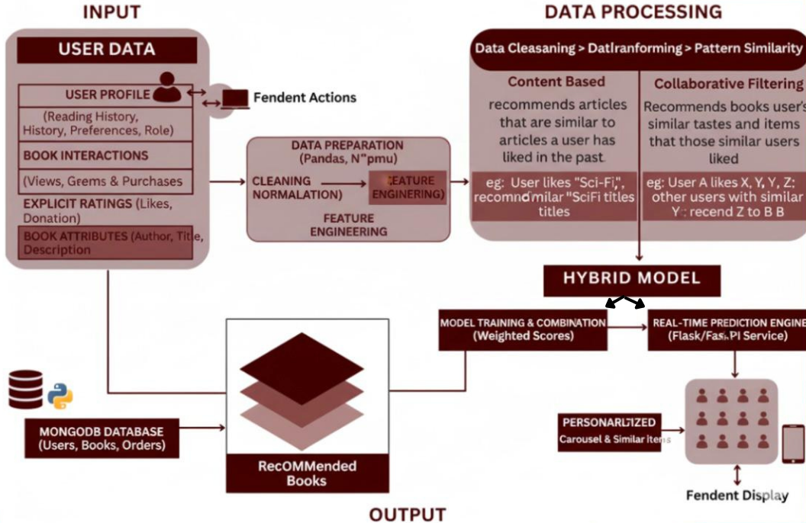
System Design
Fig 1: System Design for Hybrid Model

Slide 11
Technologies
Frontend Development:
  HTML
  CSS
  JavaScript
Backend Development:
  Django 4.2.5 and Flask
  MongoDb and Mysql
AI/ML: scikit-learn, pandas, NumPy → recommendation engine
Hybrid approach → user history + similarity search

Slide 12
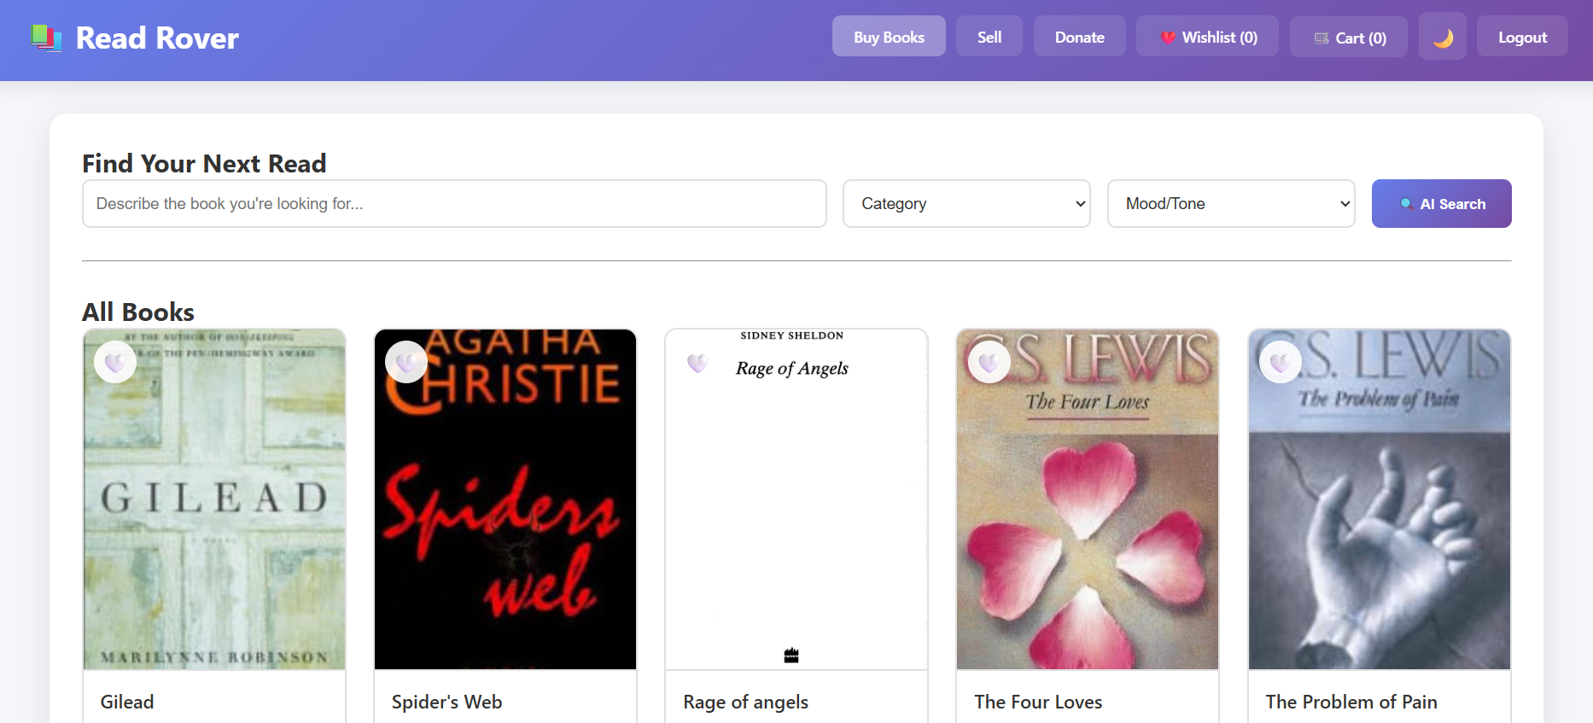
Implementation

Slide 13
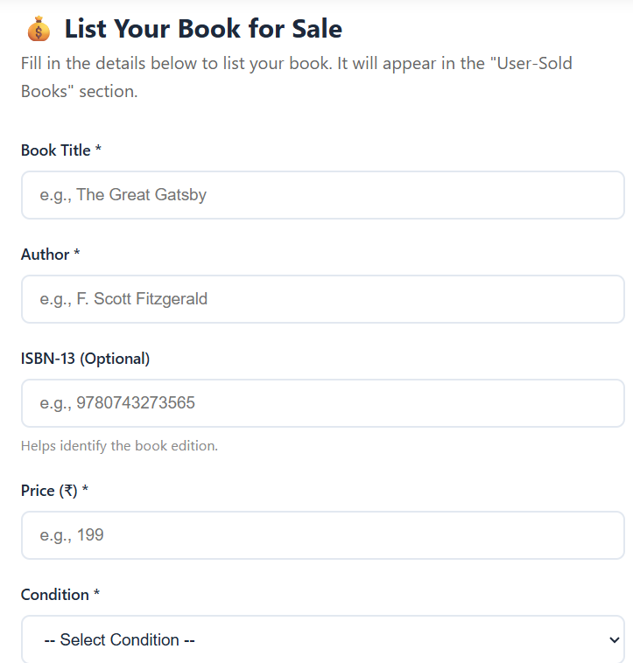
Implementation

Slide 14
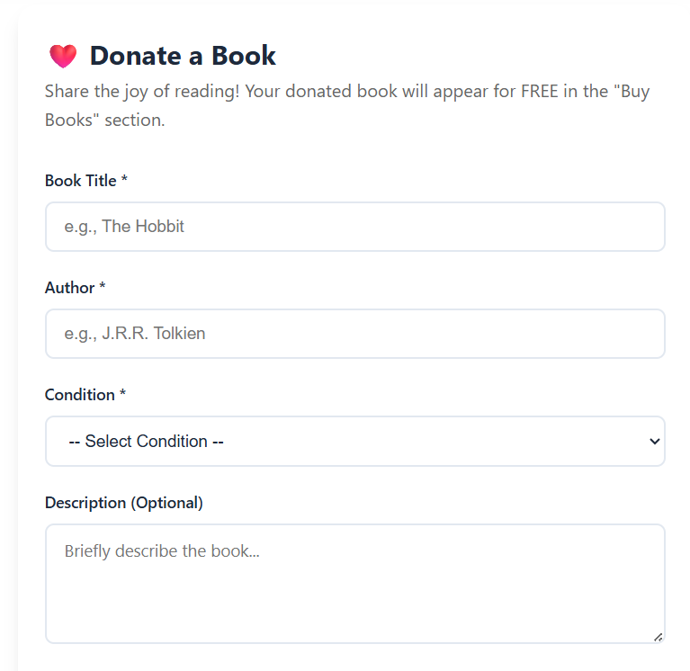
Implementation

Slide 15
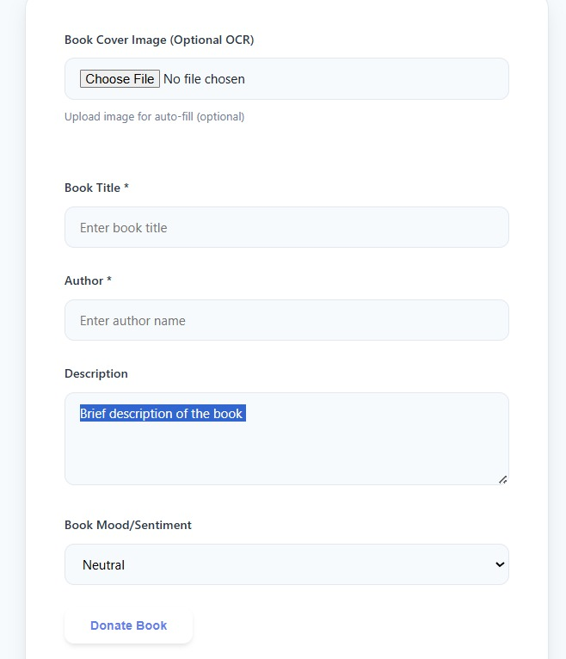
Implementation

Slide 16
Conclusion
Developed a platform for affordable, sustainable, and community-driven reading.
Future work: Mobile app, blockchain for donation tracking, multilingual support, gamification.
Final note: Bridges gap between unused books and communities in need → promotes literacy & sustainability.

Slide 17
References
Research Papers-
Smith, R. – Tesseract OCR Engine (ICDAR).
Koren, Y. – Matrix Factorization in Recommender Systems (IEEE).
Burke, R. – Hybrid Recommender Systems (UMUAI).
Technical Docs-
FastAPI Docs, PostgreSQL FTS, Redis Docs, OpenCV Docs, Tesseract OCR, Sentence-Transformers, FAISS.
APIs & External-
Open Library API, Razorpay API, Stripe API, ReportLab Toolkit.
General
Nielsen, J. – Usability Engineering. OWASP – Top 10 Security Risks.

Slide 18
Thank You...!!

